Slide 1
Blockchain animals selling
Schenikova Snezhana
Group B15.13.PU
Grid & Cloud Technologies
2019

Slide 2
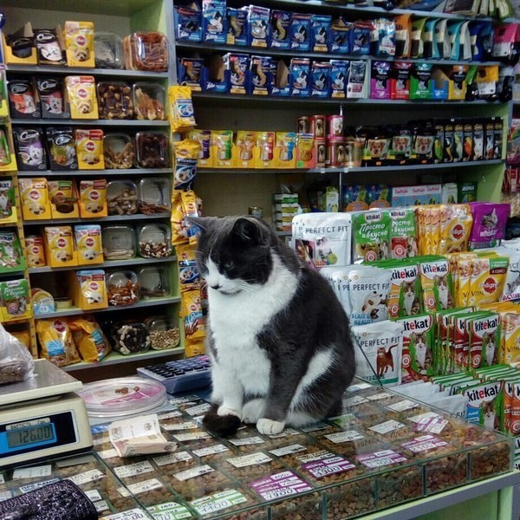
The problem
Nowadays many people would like
to have an animal in his house. But when they buy
it there is not a guarantee that this animal is really
healthy
Sometimes the cost can be high anв the animal –
matched animal without grafting
The problem is the buyer can be deceived
Therefore, it is proposed to use blockchain technology to organize buying a healthy animal

Slide 3
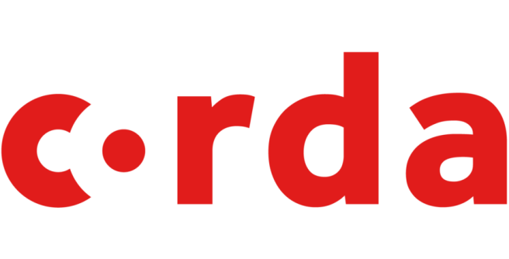
Why Blockchain and Corda
Blockchain provides an opportunity to purchase an animal from anywhere in the world
The sellers are legal companies that offer an animal with a real certificate of vaccinations
The buyers can believe the accuracy of the information about animal
Corda is an open and clear source
Corda gives you an opportunity to transact in strict privacy
The platform uses special "notarial" nodes for checking and signing transactions

Slide 4
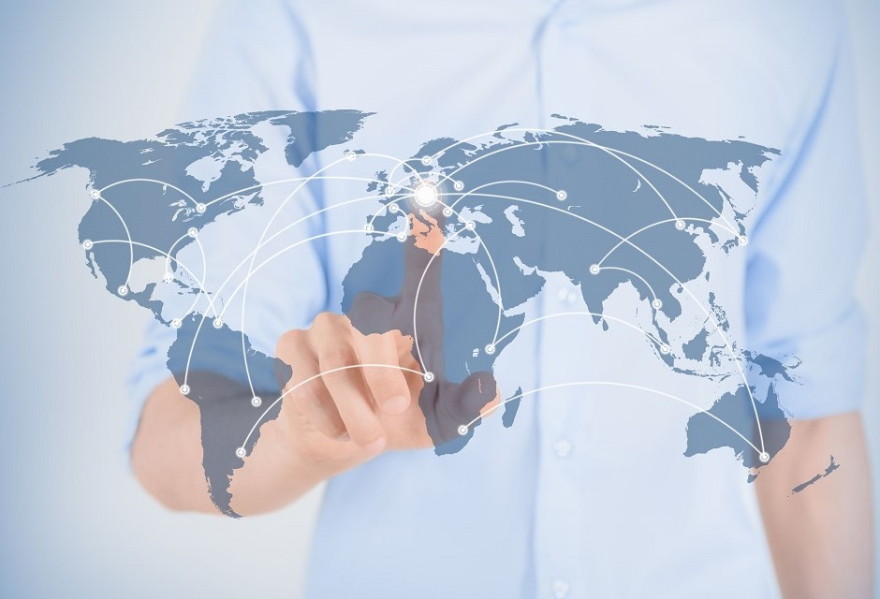
Algorithm
1.Buyer X is looking for a specific animal. He send his request to the store Y
2.Store Y verify is buyer is a real person and is data that he send right
3.If the transaction took place, notary confirms
4.Confirmed orders are recorded in the company's sales history
Every seller can write down a new buyers’ order, every buyer can get information about all his orders

Slide 5
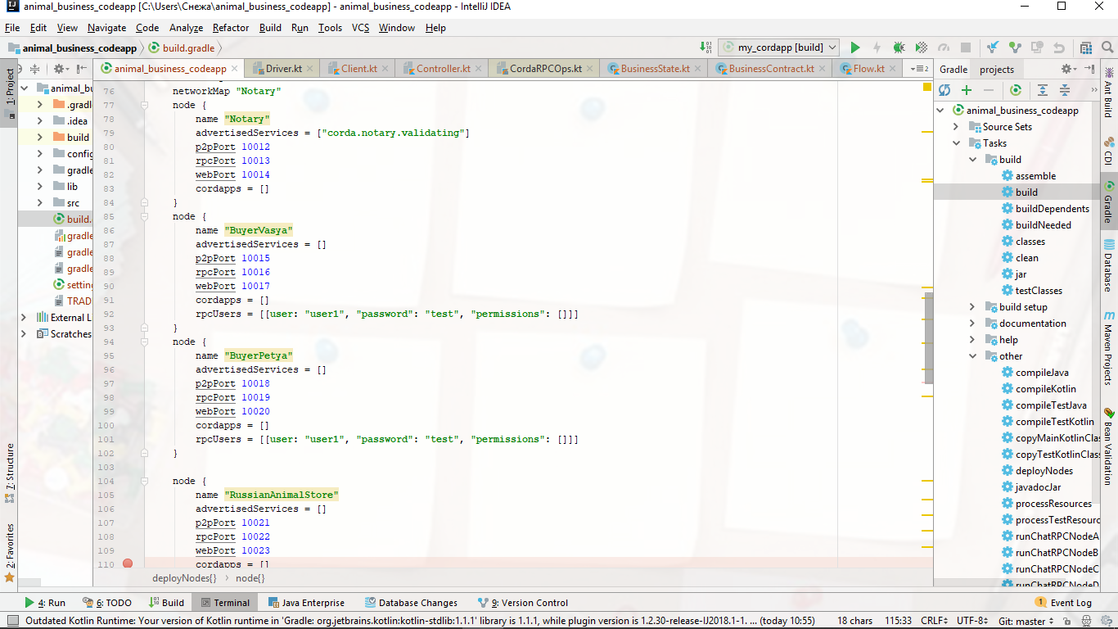
Nodes and code architecture
RussianAnimalStore
localhost:10023
Nodes:
2 writers(stores),
2 readers(buyers),
1 node as a Notary
BuyerVasya
localhost:10017
BuyerPetya
localhost:10020
EnglishAnimalStore
localhost:10026
Notary
Signs certificates
How it works:
Buyer creates a new transaction proposal and signs it
Buyer sends the proposal and his signature to Store
Store inspects the proposal, verifies it and then signs it
The transaction and signatures are sending to Notary
Notary signs the deal
An example of creating a node:

Slide 6
Nodes and code architecture
Structure
State
Contract
contract
participants
isRelevant()
toString()
POST query
Flow
verify()
Send
call()
progressTracker:
Verify data please…
Create a new state please…
1.CREATE
2.VERIFY
3.SEND
Everything is OK!
signature is created!
Notary
200
Response.Status.CREATED
The main classes:
1.Main: start nodes & webservers
2.Client : create RPCClient
3.Controller: make a connection between get/post request and services

Slide 7
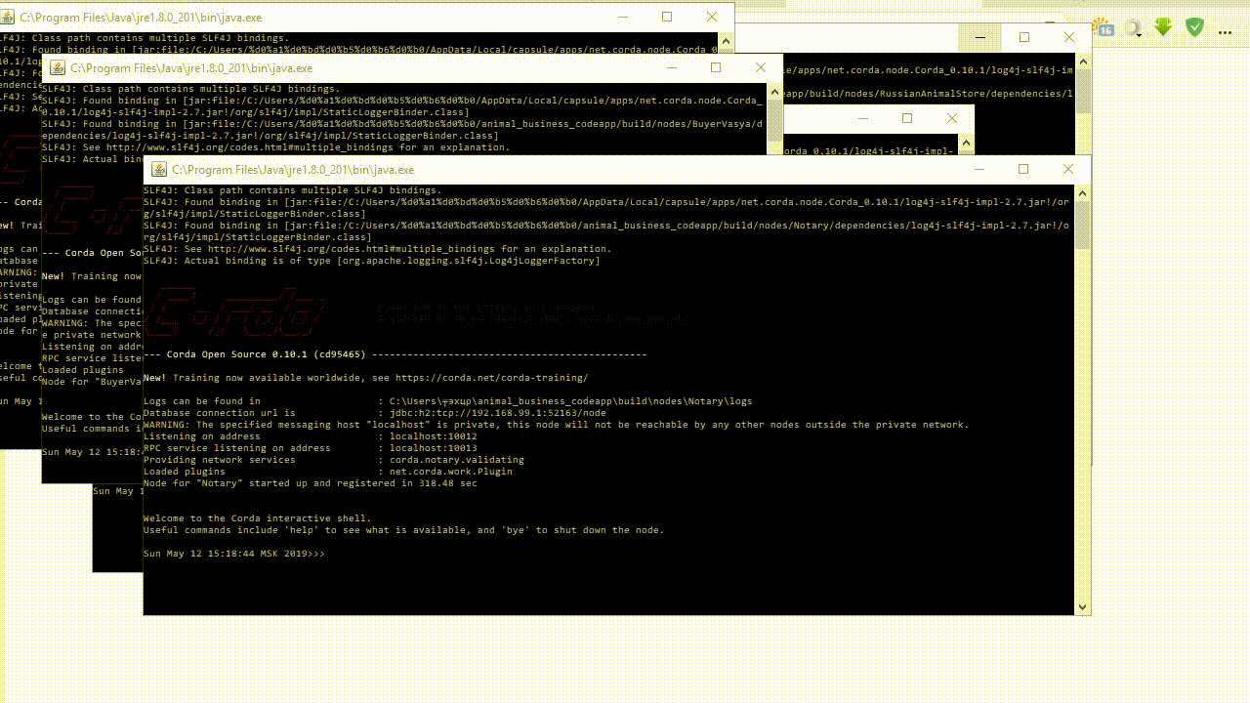
In-Use

Slide 8
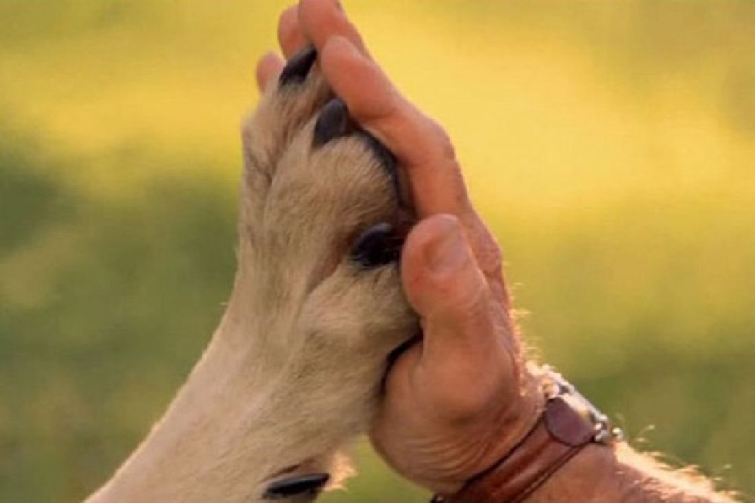
Results
Transactions to Corda are not broadcast to all
of its participants, but only to those who have
the right to view a particular record.
This application provides the opportunity to
buy healthy animals.
The establishment by each party of the level of
confidence in the notarial nodes of the partner
and the mutual verification of identification
certificates are the basis of security

Slide 9
Thank you for your attention!
Link:
https://github.com/Snezzz/animal_business_codeapp

